Slide 1
Health Monitoring of Civil Structures with UGV using Deep Learning Algorithm
Guided By
Dr.Jayashree L S
Professor
Dept Of CSE
Presented By
Jaswanth S
17MZ04
M.E CSE

Slide 2
Introduction
Cracks in concrete structures create lots of problems especially in old buildings; timely identification and curing the cracks which has occurred on concrete can help in increasing the life time of the buildings.
With the development happening in a rapid pace, there are lots of sky scrappers being built. It is not easy for a human to scan the surface of structures with naked eye and spot the cracks. This problem has to be solved so that the process takes less time to detect cracks in concrete structures.
Once the crack(s) are identified it will be easy to cure them which will increase the lifespan of the structure.

Slide 3
Objective
To develop a system to identify and spot crack(s) in civil structures.

Slide 4
Proposed System
The proposed system uses an Unmanned Ground Vehicle(UGV) for data acquisition and estimating the severity of the crack.
The UGV is made using raspberry pie and the deep learning model is embedded on it.
The algorithm being used is MASK RCNN.

Slide 5
Existing Techniques
The existing technique uses HSV thresholding where the accuracy will be reduced in some conditions.
It is not sure that the same technique will be effective for various other scenarios like, walls which are not painted.
Also there has to be someone at the backend to keep on monitoring the system for the performance.
To overcome these problems we are trying to solve the issue using Deep Learning Techniques.

Slide 6
MASK RCNN Algorithm
Mask-RCNN used individual segmentation of objects in a scene and located instances using pixel wise location for our class.
Mask-RCNN algorithm is a variation of Faster R-CNN where it detects the instances of the class. But to add a splash of colour we need to further extend the same.
The algorithm reduces the size of the image to 1/32th of the original size of the image.
Then on the resized image class prediction is done and then finally the image is brought back to the original dimension by sampling and deconvolution.

Slide 7
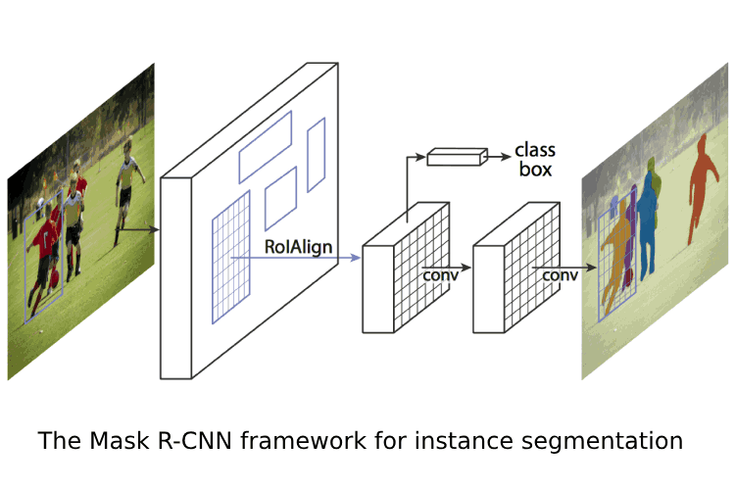
MASK RCNN Algorithm

Slide 8
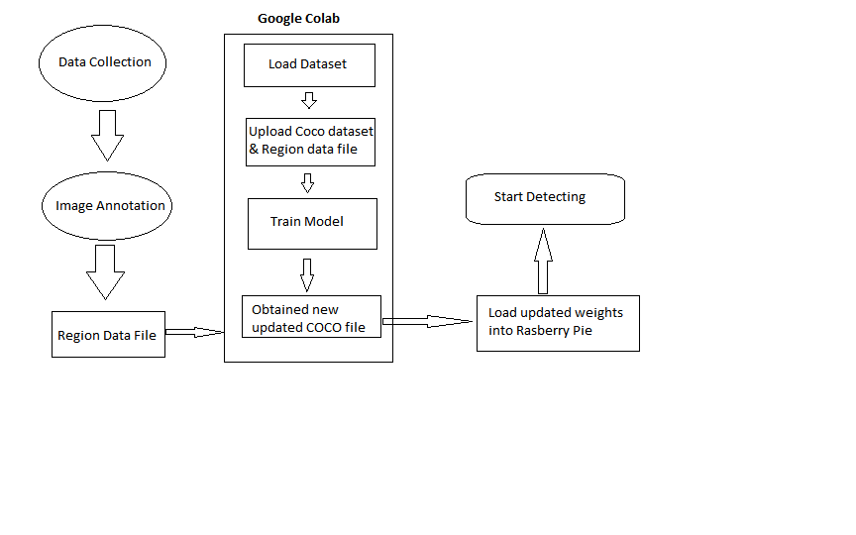
System Design

Slide 9
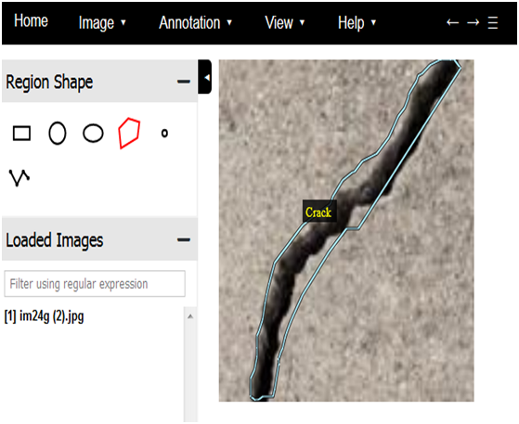
Image Annotation

Slide 10
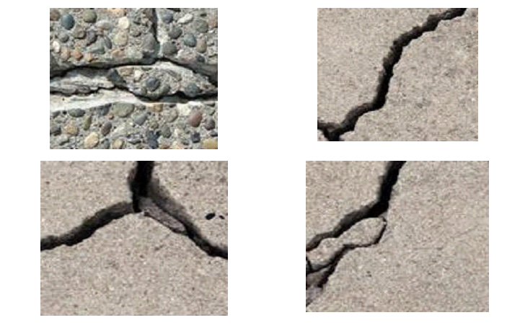
Sample Images Annotated

Slide 11
Evaluation Metrics
Precision & Recall
 | Crack | Not Crack | Total
Crack | 87 | 26 | 113
Not Crack | 13 | 74 | 87
 | 100 | 100
Recall 87%
Precision 77%

Slide 12
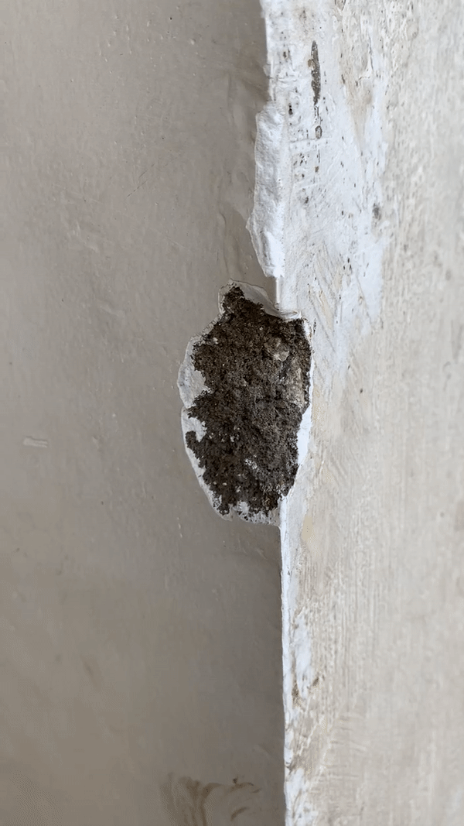
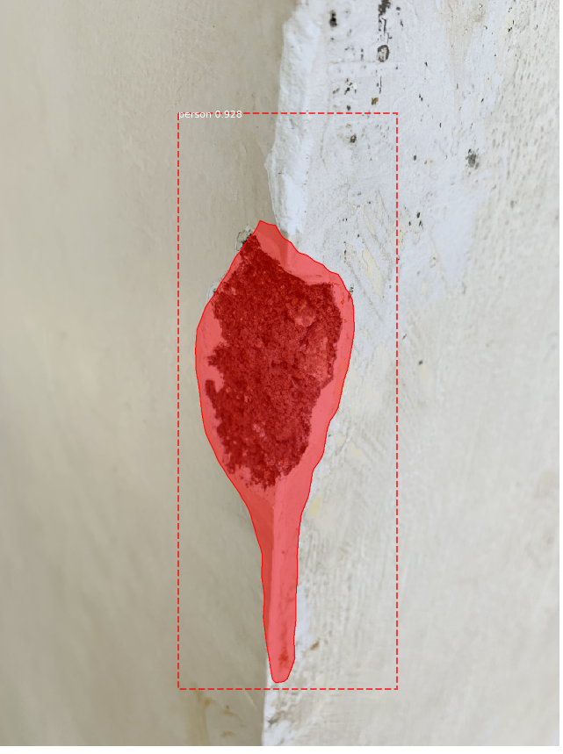
Experimental Results
Sample Video input
Identified and Masked

Slide 13
References

Slide 14
Thank You

